Slide 1
jQuery Begins
Lesson 5.1

Slide 2
Today’s Class
jQuery $(Begins)

Slide 3


Agenda
In today’s class we’ll be covering:
DOM manipulation using plain JavaScript
DOM manipulation using jQuery
Responding to click events
jQuery $(Begins)

Slide 4
DOM Manipulation
jQuery $(Begins)

Slide 5
Understanding the DOM
Every HTML page begins as static content.
However, with Javascript/jQuery, we can modify the DOM and change this static content in real time.
This allows us to build dynamic sites.
jQuery $(Begins)
Notes:
Spend a few moments explaining the concept of DOM manipulation.
Example: file:///Users/sshadley/uw/UW-SEA-FSF-PT-11-2019-U-C/04-web-apis/3-thursday-client-side-storage/activities/28-Stu_Local-Storage-Todos/Solved/index.html

Slide 6
01-DOM-Manipulation
jQuery $(Begins)
Notes:
Live code DOM manip 1

Slide 7
Activity: Generating HTML with Plain JavaScript
02-JSDrinkList
jQuery $(Begins)
Notes:
15 minutes

Slide 8
Intro to jQuery
jQuery $(Begins)

Slide 9

Intro to jQuery
jquery.com
jQuery is a cross-platform JavaScript library designed to simplify client-side HTML scripting.
jQuery $(Begins)
Notes:
* Spend a few moments to introduce the concept of jQuery.
* In your discussion, explain that:
* JavaScript alone is not ideal for performing these kinds of HTML modifications. Instead, jQuery provides a simplified syntax for doing the same tasks.
* Explain the concept of a "library" (i.e. a pre-built set of JavaScript methods that allow you to more easily perform functions.) Try to have students see how this concept of a library is similar to the concept of a CSS Framework like Bootstrap.
* Go through the slides on use cases.
(split the above into multiple slides)

Slide 10
JavaScript Query Helper Library
jQuery can be useful for tasks such as:
Dynamically inserting, updating or removing HTML
Registering click or other change events
Animating HTML elements
Downloading data from databases
And much more!
jQuery $(Begins)

Slide 11
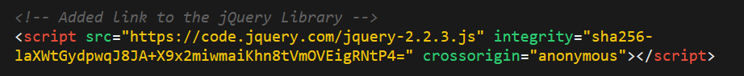
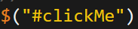
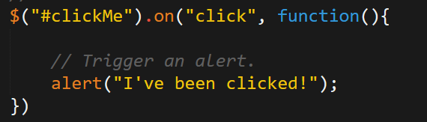
Working with jQuery
01
Include a CDN (Content Delivery Network) link to the jQuery script.
02
Utilize the jQuery specific ($) selector.
03
Apply jQuery methods on the selected elements.
jQuery $(Begins)

Slide 12
03-jQueryGenerators (DOM Manipulation with jQuery)
jQuery $(Begins)

Slide 13
Activity: Generating HTML with jQuery
04-jQueryDrinkList
jQuery $(Begins)
Notes:
15 minutes

Slide 14
On-Click Basic (05-OnClickBasic)
jQuery $(Begins)

Slide 15
Partner Activity: Sandwich Clicking 06-SandwichClick
jQuery $(Begins)
Notes:
20 minutes

Slide 16
Partner Activity: Trigger Random 07-TriggerRandom
jQuery $(Begins)
Notes:
12 minutes

Slide 17
Partner Activity: Lottery Generator 08-LotteryGenerator
jQuery $(Begins)
Notes:
20 minutes

Slide 18
Challenge: Number Checker 09-NumberChecker
jQuery $(Begins)
Notes:
20 minutes

Slide 19
Questions?
jQuery $(Begins)

